Slide 1
Basic file operations in C++

Slide 2
Learning Objectives
C++ I/O streams.
Reading and writing sequential files.
Reading and writing random access files.

Slide 3
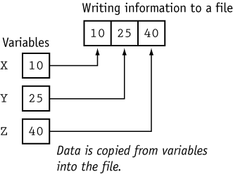
Figure 1-1

Slide 4
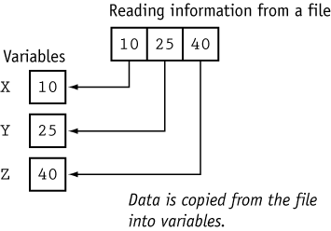
Figure 1-2

Slide 5
What is a File?
A file is a collection on information, usually stored on a computer’s disk. Information can be saved to files and then later reused.

Slide 6
File Names
All files are assigned a name that is used for identification purposes by the operating system and the user.

Slide 7
Setting Up a Program for File Input / Output
Before file I/O can be performed, a C++ program must be set up properly.
File access requires the inclusion of
# include <fstream>

Slide 8
Input & Output with files
C++ provides the following classes to perform output and input of characters to/from files:
ofstream: Stream class to write on files
ifstream: Stream class to read from files
fstream: Stream class to both read and write from/to files.

Slide 9
Path of file
Before data can be written to or read from a file, the file must be opened.
ifstream inputFile;
inputFile.open(“customer.txt”);
// Path of file using :
ifstream fin("D:\\data.txt ");

Slide 10
Why use File Handling
For permanent storage.
The transfer of input - data or output - data from one computer to another can be easily done by using files.

Slide 11
How to achieve File Handling
For achieving file handling in C++ we need to follow these steps
  Naming a file
  Opening a file
  Reading data from file
  Writing data into file
  Closing a file

Slide 12
Functions use in File Handling
Function | Operation
open() | To create a file
close() | To close an existing file
get() | Read a single character from a file
put() | write a single character in file.
read() | Read data from file
write() | Write data into file.

Slide 13
Defining and Opening a File
The function open() can be used to open multiple files that use the same stream object.
Syntax
file-stream-class stream-object;
stream-object.open("filename");
Example
ofstream outfile; // create stream
outfile.open ("data.txt"); // connect stream to data.
Closing a File
A file must be close after completion of all operation related to file. For closing file we need close() function.
Syntax
outfile.close();

Slide 14
File Opening Mode
Mode | Meaning | Purpose
ios :: out | Write | Open the file for write only.
ios :: in | Read | Open the file for read only.
ios :: app | Appending | Open the file for appending data to end-of-file.
ios :: ate | Appending | Take us to the end of the file when it is opened.
ios: trunc | Truncate | Discard the files’ contents if it exists
ios:: binary | Binary | Read/write data in binary format
Example
fstream file;
file.Open("data.txt", ios :: out | ios :: in);

Slide 15
Writing to file
#include <iostream>
#include <fstream>
using namespace std;
int main () {
ofstream myfile;
myfile.open ("example.txt");
myfile << "Writing this to a file.\n";
myfile.close();
return 0;
}

Slide 16
Writing to file
#include <iostream>
#include <fstream>
using namespace std;
int main()
{
char x = 's';
int d = 77;
double i = 3.14;
ofstream fout("data2.txt");
fout << x << d << “ ” << i ;
fout.close();
cout << "File Completed\n";
return 0;
}

Slide 17
Writing to file
#include<iostream>
#include <fstream>
using namespace std;
int main()
{
ofstream fout(“even.txt");
for(int i=4;i<=200;i++)
{
if( i % 2 == 0 )
fout<<i<<" is a even number\n";
}
fout.close();
}

Slide 18
Writing to file
#include <iostream>
#include <fstream>
using namespace std;
int main () {
ofstream myfile ("example.txt");
if (myfile.is_open())
{
myfile << "This is a new file created in cpp.\n";
myfile << "This is another line.\n";
myfile.close();
}
else
cout << "Unable to open file";
return 0;
}

Slide 19
Testing for Open Errors
dataFile.open(“cust.txt”, ios::in);
if (!dataFile)
{
cout << “Error opening file.\n”;
}

Slide 20
Another way to Test for Open Errors
dataFile.open(“cust.dat”, ios::in);
if (dataFile.fail())
{
cout << “Error opening file.\n”;
}

Slide 21
Read From File (Character by Character)
ifstream inputFile("info.txt");
char ch;
while (inputFile.get(ch))
{
cout << ch<<endl;
}
inputFile.close();

Slide 22
Read From File (Word by Word)
ifstream inputFile("info.txt");
string word;
while (inputFile >> word)
{
cout << word<< endl;
}
inputFile.close();

Slide 23
Read From File (Line by Line)
ifstream inputFile("info.txt");
string line;
while (getline(inputFile, line))
{
cout << line << endl;
}
inputFile.close();

